Slide 1
Week 2-3
Project Start and Literature review

Slide 2
Understand what we have from previous years Projects
2023 Project #62 : Website Frontend Monitoring Tomato Farm
Github Link
Key tech used:
- NPM
- TypeScript
- React
- Vite
- eslint
- prettier
- Ant design
- SASS
2022 Project #22: Plant Monitoring System For Smart Farm
Key tech used:
-MMDetection

Slide 3
Literature Focusing
How to use DNN models.
Create server backend and connect with frontend.
AI server.
Understanding Tomato DNN models functions.
Estimate tomato growth and harvest time.

Slide 4
Literature and Document relevant link
Literature:
Prediction of Harvest Time of Tomato Using Mask R-CNN
A CNN Method Based Predictive Model for Tomato Leaf Disease Prediction
TLNet: A Deep CNN model for Prediction of tomato Leaf Diseases
Tomato Ripeness Evaluation and Localization Using Mask R-CNN and DBSCAN Clustering
How to write literature review:
Writing a Literature Review
Build and Setup Your Own Deep Learning Server From Scratch

Slide 5
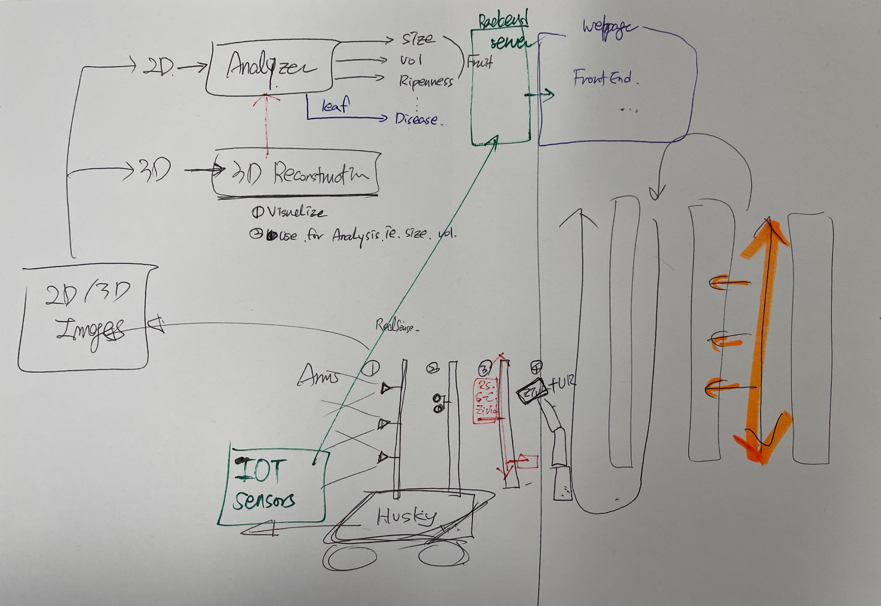
Problem Statement
How do we create a backend and AI server that could receive the data from IOT sensors, using 2D DNN model to analysis the result, then correctly showing the result onto the webpage?

Slide 6
Our Goal
Understanding Website Structure from previous years project.
Understanding Plant Monitoring System from 2022 Project.
Create backend server for the website.
Create AI server for process resource from 3D image/model to 2D DNN model.
Improve Frontend UI.
Final goal : Integrate 2D based DNN model, Backend and server, website, robot with camera etc, and show all data on webpage and estimate tomato harvest time.

Slide 7
Things what we did
Read some literature for literature review
Make a plan and project goal
Discuss what we need to show on website.

Slide 8
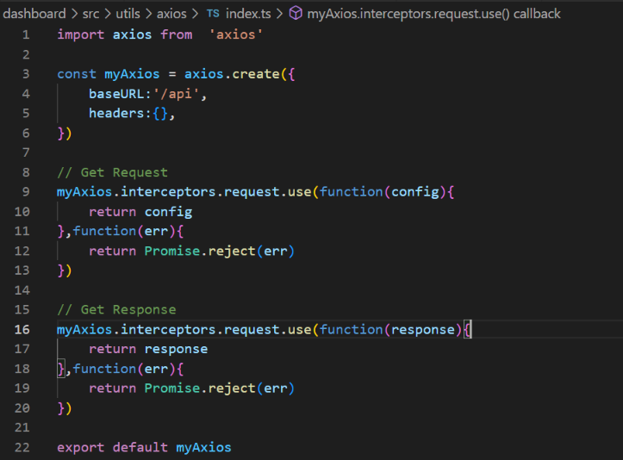
Adding and Initialize Axios for frontend
In utils folder of PLANT-DASHBOARD-3D program, we create a index.ts file in utils/axios folder.
Use the code on right create an axios that can be use in the project to communicate with backend using HTTP protocol by POST, GET etc.

Slide 9
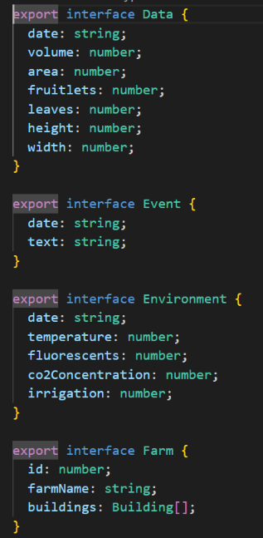
Simplified data.ts
Originally, file data.ts stored not only the type of data needed to provide to the page, but also a entity that collect all the fake datas. If we want the frontend to be with support from backend, we will want the data.ts only stored the type of the data we need, things like what kind of datas (example like id, name, environment parameters) are need in that type. So we create two backup file, one store changes and one is the original file

Slide 10
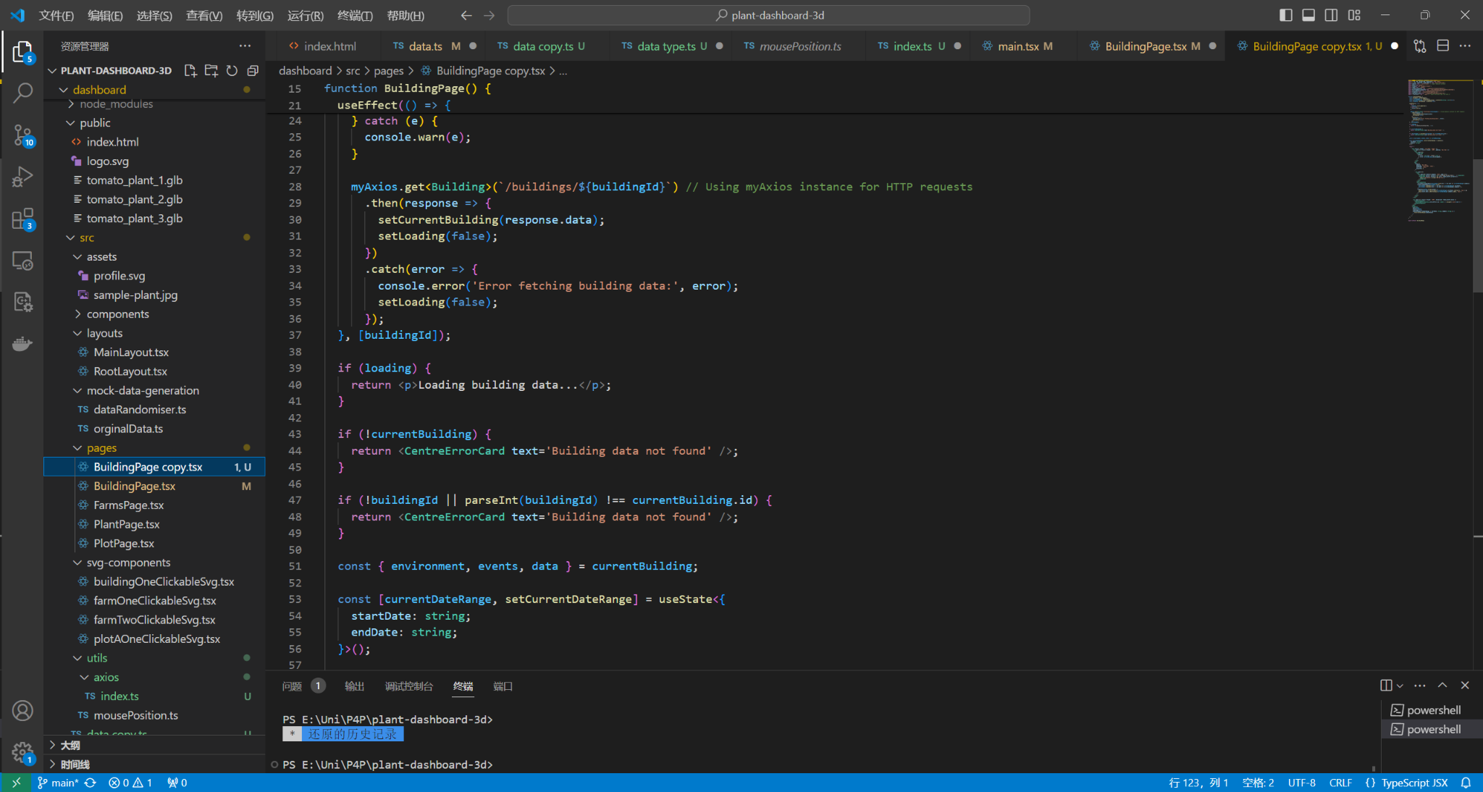
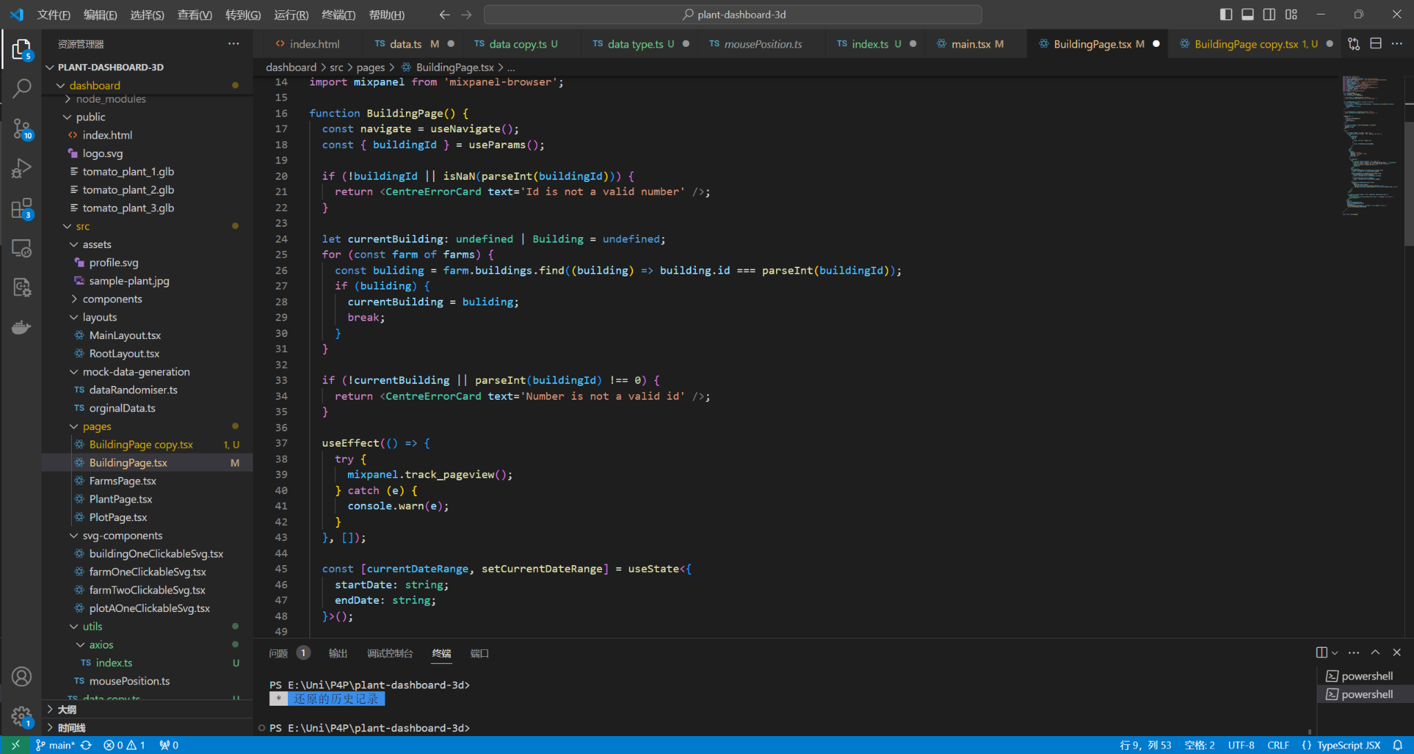
Implement Axois to connect Frontend and Backend
Original
Edit

Slide 11
Frontend logic
The current frontend implementation heavily relies on the data.ts default export for its logic. Each page and SVG component imports this default export entity, "farm", making it challenging to integrate Axios for HTTP GET or POST requests across different pages. As a result, the conventional approach to connect the frontend and backend through Axios, established in previous pages, is inaccessible. To address this, we need to modify data.ts to initialize data retrieval from the backend upon server startup.

Slide 12
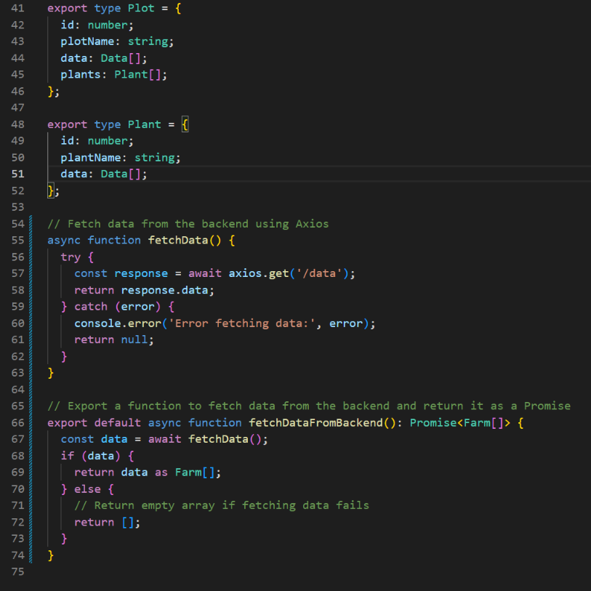
Improve solution
We implement the axios function at the end of data.ts to let it do HTTP get, this will change the “farm” that used in every file.

Slide 13
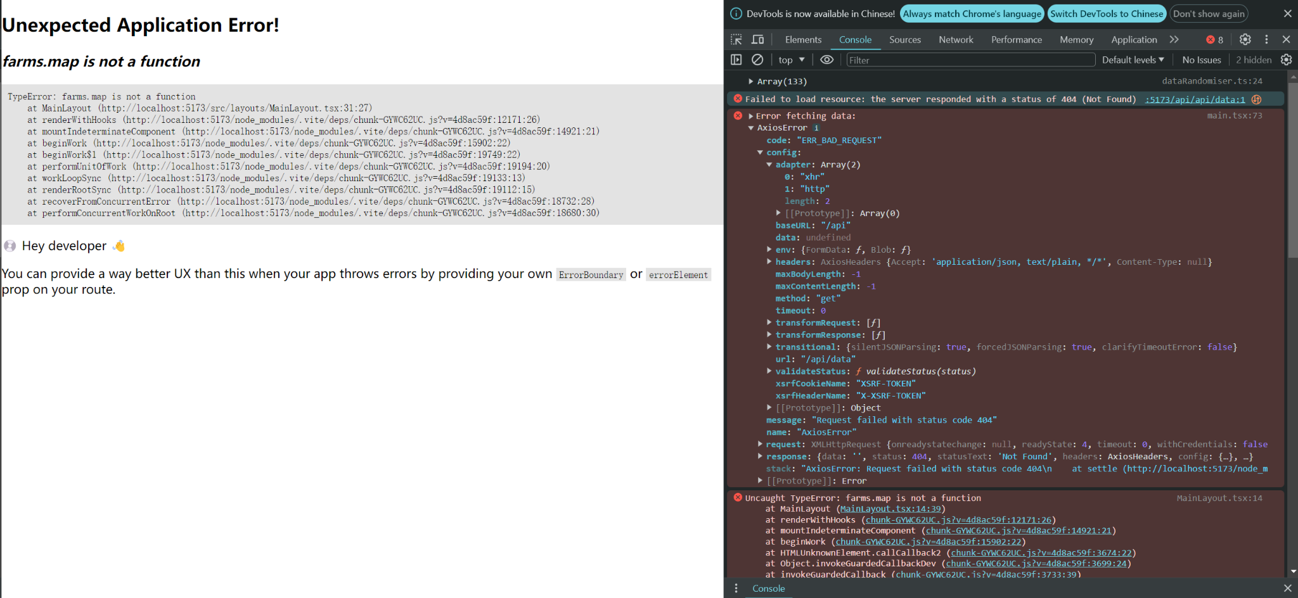
Result after change
We can see from the image at right that the frontend had make a request to the backend, because our backend wasn’t running right now, so it failed to load resources

Slide 14
Backend
Using Flask to build backend with mysql for database.
First step is making simple backend and connect with DB and frontend.
Therefore it will show data from DB on frontend.
After connecting successfully with showing DB

